Slide 1
Designing Deep Neural Networks
Week 10

Slide 2
Recap
Seen neural networks
Familiar with main components
Basic idea of training: gradient descent
Today: Designing neural networks

Slide 3
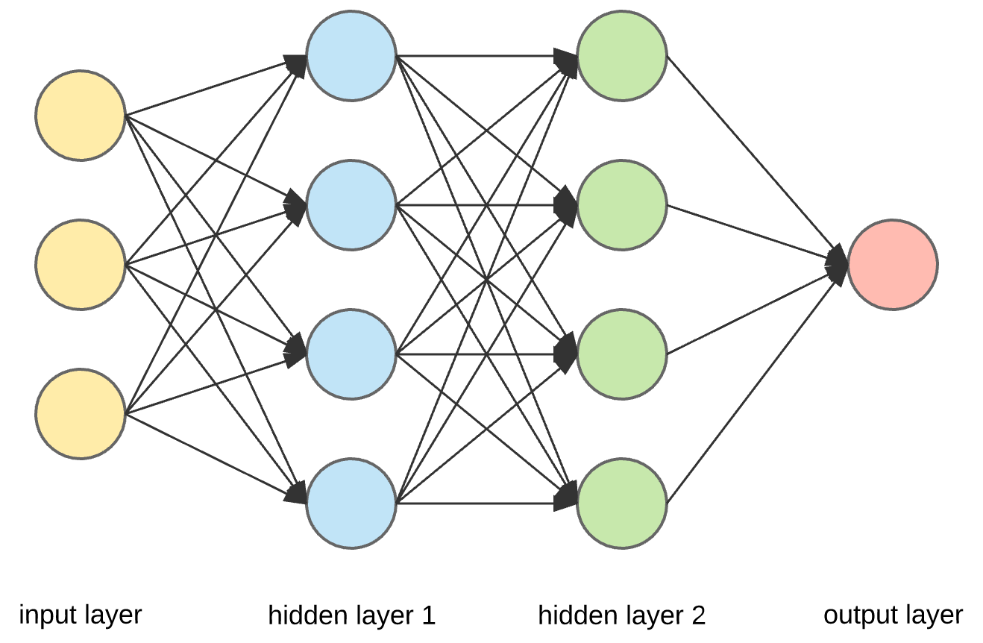
Design Decisions
Output layer
Neurons
Activation functions
Hidden layers
Depth
Width
Activation function
Input layer
neurons
Architecture
Optimizer

Slide 4
Input Layer
Any guess?
Boston problem (14 features and 1 output)
MNIST problem (28x28 images)

Slide 5
Output Layer
Parameters of interest
Neurons
Activation function
Cost function
Boston problem
Binary classification
Multi-class Classification

Slide 6
Hidden Layer
Activation Functions
Sigmoid
Tanh
Rectified linear
Many others
Validation Testing

Slide 7
Architecture
Depth
Width
Universal Approximation Theorem
No Free Lunch Theorem
Special architectures

Slide 8
Optimizers
Almost all work using gradients
Different optimizers work better with different activation function
Again test and trial

Slide 9
Recap
What have we learned today?
Do you feel more confident in designing deep networks
Next week: CNNs

